Slide 1
Chi-Square Test

Slide 2
Chi-Square (χ²) Test
Used to determine if there is a significant difference between the expected and observed data
Null hypothesis: There is NO statistically significant difference between expected & observed data
  Any differences are due to CHANCE alone

Slide 3
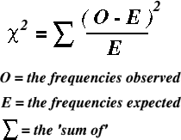
Chi-Square (χ²) Formula

Slide 4
How to use the Chi-Square Test
Determine null hypothesis
  All frequencies are equal –OR– Specific frequencies given already
Use formula to calculate χ² value:
  n = # of categories, e = expected, o = observed
Find critical value using table (Use p=0.05).
  degrees of freedom (df) = n – 1
If χ² < Critical Value, then ACCEPT null hypothesis. Differences in data are due to chance alone.
    If χ² > Critical Value, REJECT the null hypothesis: Differences in data are NOT due to chance alone!

Slide 5
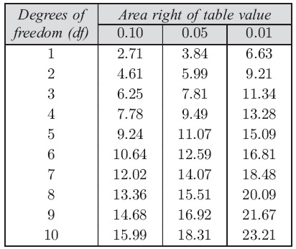

Slide 6


Slide 7
